Slide 1
British Columbia’s Carbon Tax: A Template For the World
Tom Pedersen, University of Victoria
and
Stewart Elgie, University of Ottawa
Latin American Carbon Forum, Bogota, September, 2014

Slide 2
The BC Carbon Tax:
Unique, Comprehensive, Simple, Effective
July 1, 2008: $10 per tonne of CO₂ equivalent emitted (=2.25 ¢/L of regular gasoline).
Rate depends on the carbon content of fuels (e.g. diesel is taxed slightly higher than gasoline).
Rose $5/tonne/yr to $30/t on July 1, 2012 (6.67 ¢/L on regular gas).
Minimal bureaucracy: the tax is applied at wholesale distribution points (six such points in BC).
Frozen as of June 30, 2013 at $30/tonne CO₂, until 2018. Announced issue: maintaining competitiveness.

Slide 3
The BC Carbon Tax, continued
Revenue neutral; by law, every penny must be used to reduce other taxes.
BC now has the lowest personal income tax in Canada (up to $122,000 taxable income) and amongst the lowest corporate income taxes in the OECD and G7 countries.
Socioeconomically fair: Northern and Rural Homeowner benefit: up to $200/yr/homeowner.
Low Income Climate Action Tax Credit for families ($231/yr plus $34.50/child/year); income dependent, paid quarterly.

Slide 4
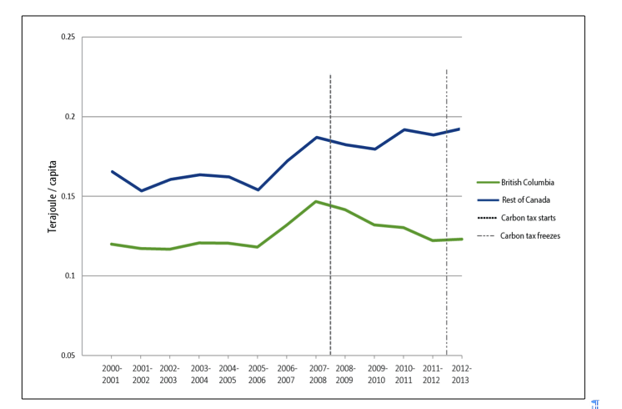
Per capita fossil fuel consumption, 2000-2013
July 1,
2008
July 1,
2012
Rest of Canada
19%
Terajoules per capita
British Columbia
Data compiled by Stewart Elgie, University of Ottawa

Slide 5
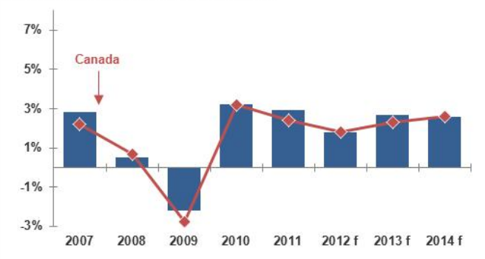
British Columbia’s Economic Performance:
% Change in GDP (f = forecast)
British Columbia
Canada
Change in GDP, %
Statistics Canada data; graph compiled by Stewart Elgie, University of Ottawa

Slide 6
Prof. Paul Ekins,
Chair of the UK’s Green Fiscal Commission:
“BC’s carbon tax is a template for the world.”
www.pics.uvic.ca

