Slide 1
Role of National Development Banks in Intermediating Climate Finance
Taller Regional
“Instrumentos Financieros para Promover la Sostenibilidad y la Mitigación del Cambio Climático –
La Experiencia de las Instituciones Financieras en América Latina y el Caribe”
Diana Smallridge, November 29, 2012

Slide 2
Why are NDBs so important in the climate finance landscape?
There is a need to scale up private sector investments in climate change activities but there are barriers that private sector investments
The unique role of national development banks (NDBs) can help overcome some of the difficulties. NDBs use a variety of different financial and non-financial instruments that can promote private sector finance, and many of them already offer such instruments for climate change activities.
NDBs can play a more effective role in scaling up investments through international climate finance if they are better integrated and recognized and can strengthen their technical capacities to play an active role in climate finance.

Slide 3
Key Features of National Development Banks
Public Sector Entity
Can interact with different levels of governments and potentially influence policy-making
Mobilizer
Works with private financial institutions and seeks to mobilize or attract co-financing
Project Structurer
Understands the risks and barriers and can shape and influence the project structure
Financial Institution
Is in the business of financing and risk taking, particularly in support of long term investments
Incubator and Aggregator
Can develop innovative and catalytic financial instruments and can manage small scale projects
Risk Taker
Can identify, manage, mitigate and assume risks that the private sector LFIs cannot
International Partner
Has access to long-term hard currency borrowings and work closely with the MDBs, bilateral DFIs and foreign ECAs
Connector
Has connections to all of the relevant public and private sector actors
Development Mandate
Promotes financing and associated market development in underserved sectors
Notes:
NDBs are government-backed, sponsored or supported financial institutions which have a specific public policy mandate.
NDBs have a privileged position in their local markets and, given a number of characteristics that are commonly associated with them, can have a potentially crucial role to play in facilitating climate investments and delivering climate finance directly or leveraging private capital.
This slide highlights the various features of a typical NDB which make it well-suited to the requirements of climate finance.

Slide 4
NDBs role in scaling up private investments
NDBs special knowledge and long-standing relationship with the private sector puts them in a privileged position to have access to the local financial markets and understand local barriers to investment.
Compared to commercial banks and investment funds, NDBs have the potential to take risks these may not be able to in addition to finance long term investments.

Slide 5
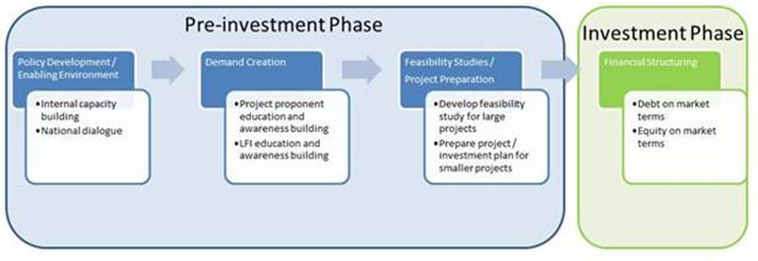
Conditions for effective scale up of private climate finance

Slide 6
Public finance from NDBs can be used to leverage private sector investments
Increasing the “demand” side for investments and finance in climate friendly projects by addressing sector- and country-specific constraints, promoting an appropriate and stable enabling environment for investment, building awareness and capacity to analyze and structure climate-related interventions, as well as bringing projects and companies to a state of investment-readiness;
Providing the necessary incentives to mobilize the “supply” of climate friendly investments from the private sector, by offering financial instruments at adequate terms and conditions for this type of projects and by supporting private investors LFIs in understanding and tackling the specific investment and financial barriers that prevent private actors to engage in ‘green’ and climate resilient projects.

Slide 7
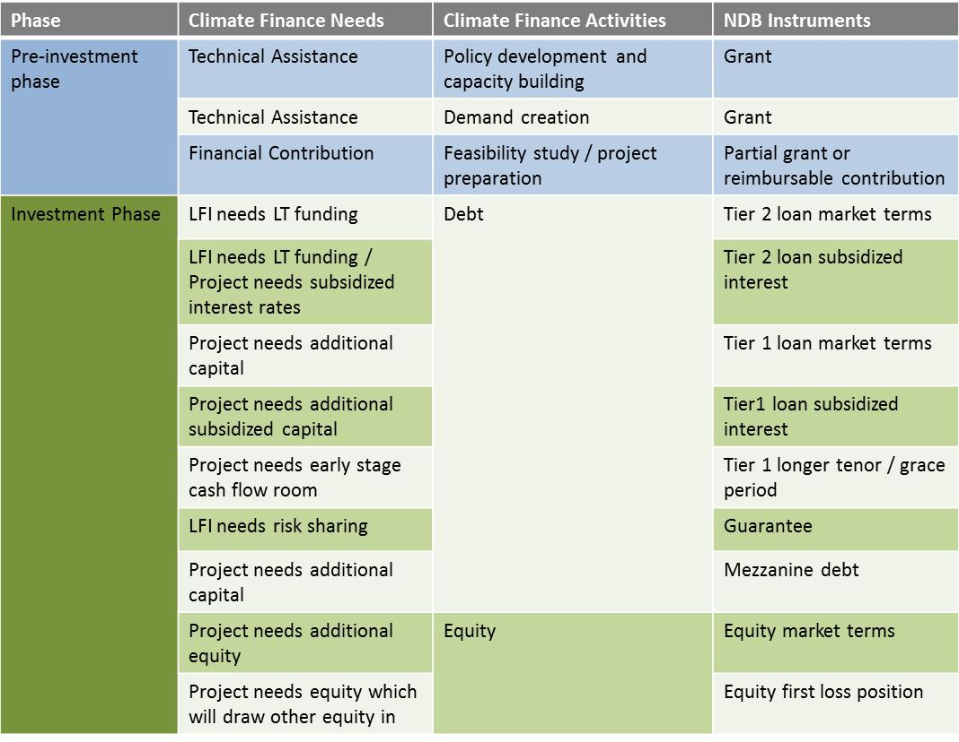
NDBs Instruments
Notes:
NDBs use a variety of different financial and non-financial instruments that can promote private sector finance – and already offer such instruments for climate change activities.
NDB activities and instruments can cover both demand and supply financing needs to mobilize climate finance, and can thus leverage scale. An NDB can apply the tools it has to meet the needs described in the pre-investment stage through grants and technical assistance, as well as in the investment stage, when the NDBs may need to offer risk enhancements, funding subsidies, or other financial structures to entice private capital into a project.
NDBs’ toolbox bears a high potential of leveraging public and private resources, both because they deploy instruments that other do not use and because of their unique role.

Slide 8
NDB’s potential to leverage private sources of capital is significant
Category of Instrument |  | NDB Theoretical Leverage Factor
Tier 1 | Non-concessional debt | 2-5 x
 | Debt financed via grants | 8-10 x
Tier 2 | Non-concessional debt | 1 x
 | Debt financed via grants | 4-8 x
Tier 1 | Direct Equity | 12-15 x
 | Equity financed via grants | 20 x
Tier 2 | Direct Equity | 12-15 x
 | Equity financed via grants | N/A
 | Guarantee at non-concessional rates | 4-8 x
 | Guarantees financed via grants | 25 x
Notes:
Based on the AGF approach, one can see that NDBs have a high potential to intermediate and mobilize climate finance.

Slide 9
Thank you – Gracias
World Exchange Plaza
P.O. Box 81119
Ottawa, Ontario K1P 1B1, Canada
Tel.: +1-613-742-7829 ext. 20
Fax: +1-613-742-7099
General Email: info@i-financialconsulting.com
Direct Email: dsmallridge@i-financialconsulting.com

