Slide 1

FIRA´s role in
Agro-industrial Sustainability
Ernesto Fernández Arias

Slide 2
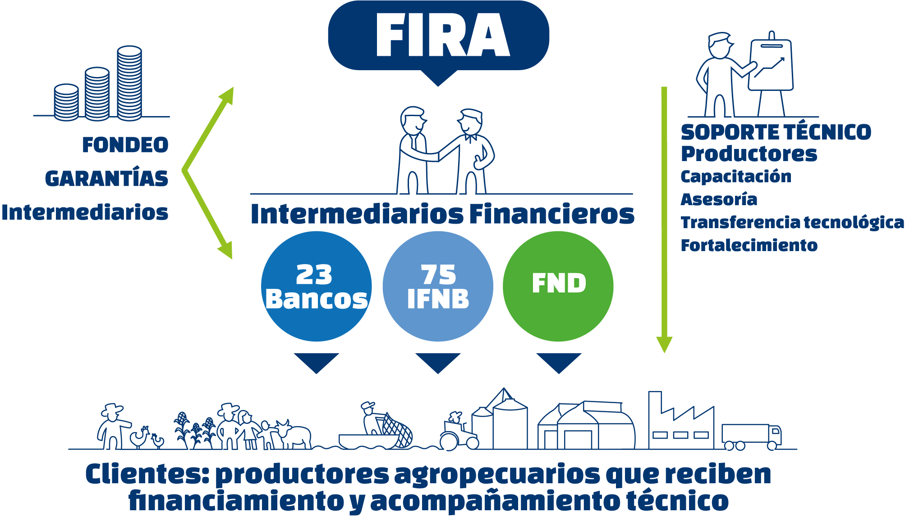
FIRA is a second tier financial institution. Its business model relies on 98 financial intermediaries from the banking and non-banking sector, as well as technological agents across the entire country.
Technical Support
to producers
Training
Technology transfer
Internal capacity strengthening
Funding
Guarantees
Intermediaries
Financial Intermediaries
Clients: agricultural producers receiving financing and technical support

Slide 3
Why do we need to finance sustainable projects?
Agricultural sector contributes with 12% of the GHG inventory in México^{1/}
Agriculture represents 70% of water consumption in Mexico
Agricultural sector is greatly exposed to the (negative) effects of climate change. According to the INECC, it is expected in coming years to observe a rise in temperature between 2.5º C to 4.5º C, and a decrease in precipitation from 5 to 10%:
  Projected decreasing yields in crop production, particularly maize, in 2050
  The rise of the sea level could affect agricultural lands by means of saline intrusion
  An increasing number and severity of tropical storms and natural disasters.
  Regarding oceans, a rise in temperature could collapse the fish stock colonies thus impacting on the productivity of fisheries.
1/ Inventario Nacional de Emisiones de Gases de Efecto Invernadero 2013
2/ INECC, Efectos del Cambio Climático en México, disponible en: http://iecc.inecc.gob.mx/efecto-cambio-climatico-en-mexico.php

Slide 4
Sustainable development, measures to alleviate climate change and programs targeting natural disasters assistance are public policies priorities in Mexico.
The sustainable projects portfolio of FIRA is mainly conformed by the following categories: Sustainable practices (e.g. no tilling techniques, greenhouse production, organic fertilizers), Efficient use of water (e.g. irrigation technologies), Renewable energy (e.g. PV projects), Energy efficiency, and biodigestors.
According to FIRA´s institutional plan there is a sustainable projects Key Performance Indicator (KPI) that establishes a goal of credit portfolio of $8,914 million pesos in 2018.
This goal represents an increment of 117% of the sustainable credit portfolio in comparison to base year 2013
Energy Efficiency projects only contribute with 5.6% of the credit portfolio of sustainable projects, thus it is identified an opportunity area
Nominal growth = 117%
* Parcial a Noviembre 2016

Slide 5



FIRA actively collaborate with international and national institutions to develop sustainable projects.
Projects in cooperation with international actors: Actor:
Programa de Eficiencia Energética (Energy Efficiency Program)
Green Bond
Manejo Forestal Sostenible (Sustainable Forestry)
  Programa de Apoyo a Proyectos Sostenibles (Sustainable Projects)

Slide 6




FIRA actively collaborate with international and national institutions to develop sustainable projects.
Projects in cooperation with national actors: Actor:
  Programa de Eficiencia Energética (Energy Efficiency Program)
  Fondo Nacional Forestal / Plantaciones forestales comerciales
  (Commercial plantations)
  FONAGA Verde (Green guarantee scheme)
  Tecnificación de riego (Irrigation technologies)
  Bioseguridad pecuaria (Livestock biosecurity)

Slide 7


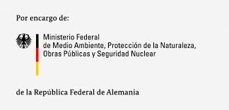
FIRA support productive projects and actions that contribute to implement the “Climate Change y agricultural production Agenda”
  The “Agenda” is the result of a joint effort of a diversity of organizations in the Mexican agricultural sector, and aims to produce climate friendly agricultural goods.
  Lines of action:
  Sustainable livestock production
  Sustainable fisheries and aquaculture
  Sustainable agriculture
  Sustainable forestry
  Energy Efficiency
  Renewable Energy
Institutions coordinating the Agenda:

Slide 8





FIRA contributes with the Global Environment Facility (GEF) through the Project: Sustainable Productive Landscapes.
The objective is to develop productive territories that promote the forest and jungles connectivity in order to preserve biodiversity and ecosystem services.

Slide 9
The Energy Efficiency Program of FIRA, as part of the ESI initiative, is an example of an innovative mechanism to foster climate change mitigation projects.
In the ESI context, with support from the Danish Energy Agency, The Inter-American Development Bank (IDB), the Clean Technology Fund (CTF), and in cooperation with Secretaría de Energía (SENER) and Comisión Nacional para el Uso Eficiente de la Energía (CONUEE), FIRA designed and developed an Energy Efficiency Program.
The objective of the program is to foster the modernization of the agroindustry sector that contribute to increase its sustainability and productivity.
The program incorporates as an innovative risk mitigation mechanism an Energy Savings Surety Bond (Fianza)
It is expected that this model will be able to mobilize climate investments through market structuring and risk mitigation instruments that unlocks the agroindustry energy savings potential.

Slide 10
FIRA´s role in
Agro-industrial Sustainability
Ernesto Fernández Arias

